Slide 1
Week 11 Lecture No. 21
Visual Programming C# & .Net Framework
Course Instructor: Dr. Malik Daler Ali Awan
01/10

Slide 2
Topic
Basic Math Cart
Database Creation
Objective: To practice Basic Mathematics and Play with different Control Elements
02/10

Slide 3
Control Elements
These are Control Elements that can be used to Design “Shopping Cart”;
Control Element | Description
Button | It is used to draw a clickable button.
Label | It is used to assign a label .
Textbox | It is used to provide a text box to get input from users and vice versa
Menus Strip | It is used to draw a navigation bar.
Note: There's are many others control elements. Check the toolbox.
03/10

Slide 4
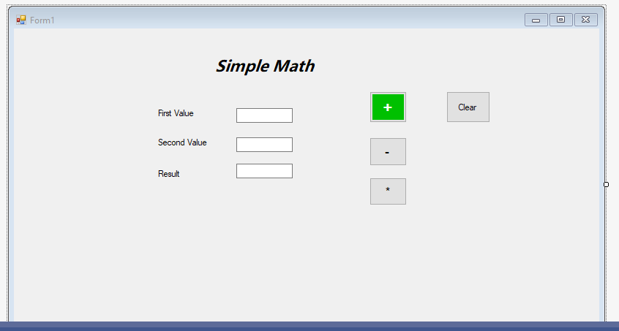
Design
04/10

Slide 5
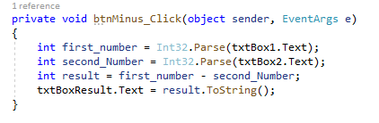
Subtraction Code
05/10

Slide 6
Explanation
Int32.Prase is used to convert the text/string to Integer
“.Text” is used to get the value of text box and store in Variable
ToString( ) method is used to convert inter to string/text
06/10

Slide 7
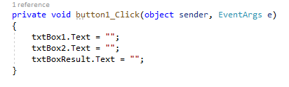
Code to Clear the Text Boxes
07/10

Slide 8
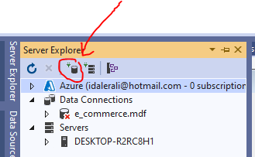
Create Database
08/10

Slide 9
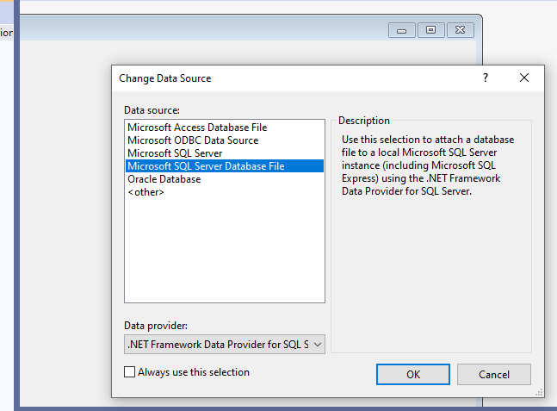
09/10

Slide 10
Thank you!
10/10

